Slide 1
The “Quiet Revolution” in Aquaculture Value Chains
Ben Belton
Michigan State University
Food Security Policy Project
World Aquaculture Society
Montpellier, France, August 27 2018

Slide 2
What is the “Quiet Revolution”?
Huge (but overlooked) changes in food value chains
Occurring across developing countries for multiple commodities (e.g. Reardon et al, 2012; Reardon et al, 2018)
  Farm commercialization, intensification, specialization
  Growth of supporting off-farm enterprises
Driven by changes in demand

Slide 3
Changes in Demand
Rapid urbanization (66% by 2050)
Urbanization → Higher incomes
Higher incomes → Diet change
More demand for non-staple foods (including fish) as diets diversify

Slide 4
Domestic markets dominate demand
Aquaculture exports and domestic consumption from the top 10 aquaculture producing developing countries
(87% of global farmed fish production)
(Belton et al, 2018a)
11
89

Slide 5
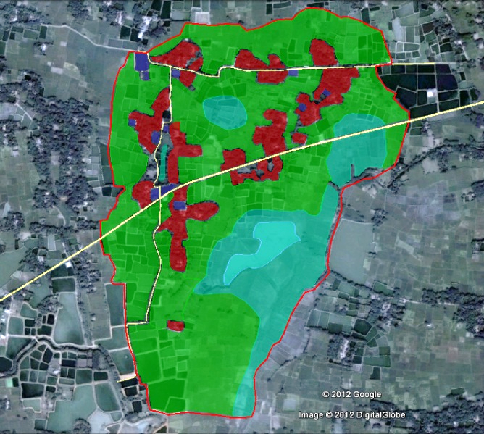
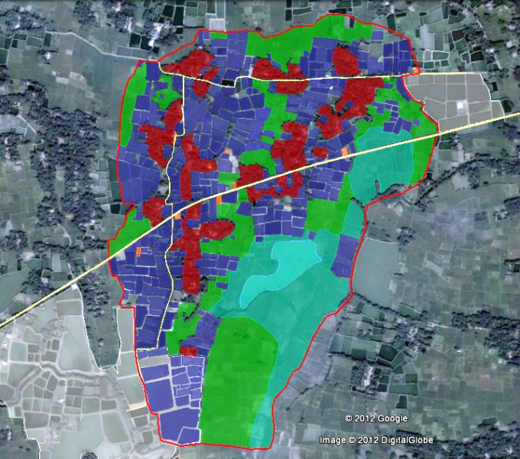
Changes in Supply
Fish farm expansion (Belton et al, 2017)
1992
2012

Slide 6
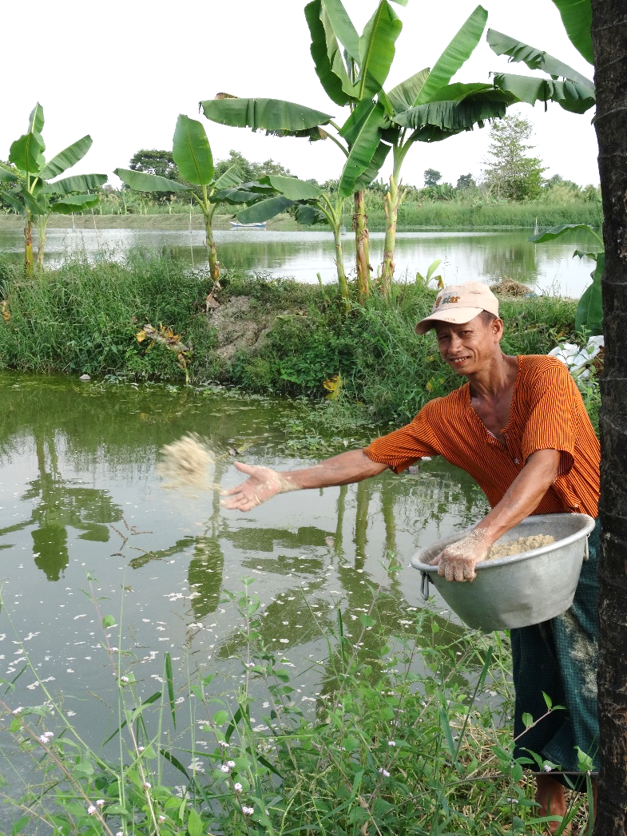
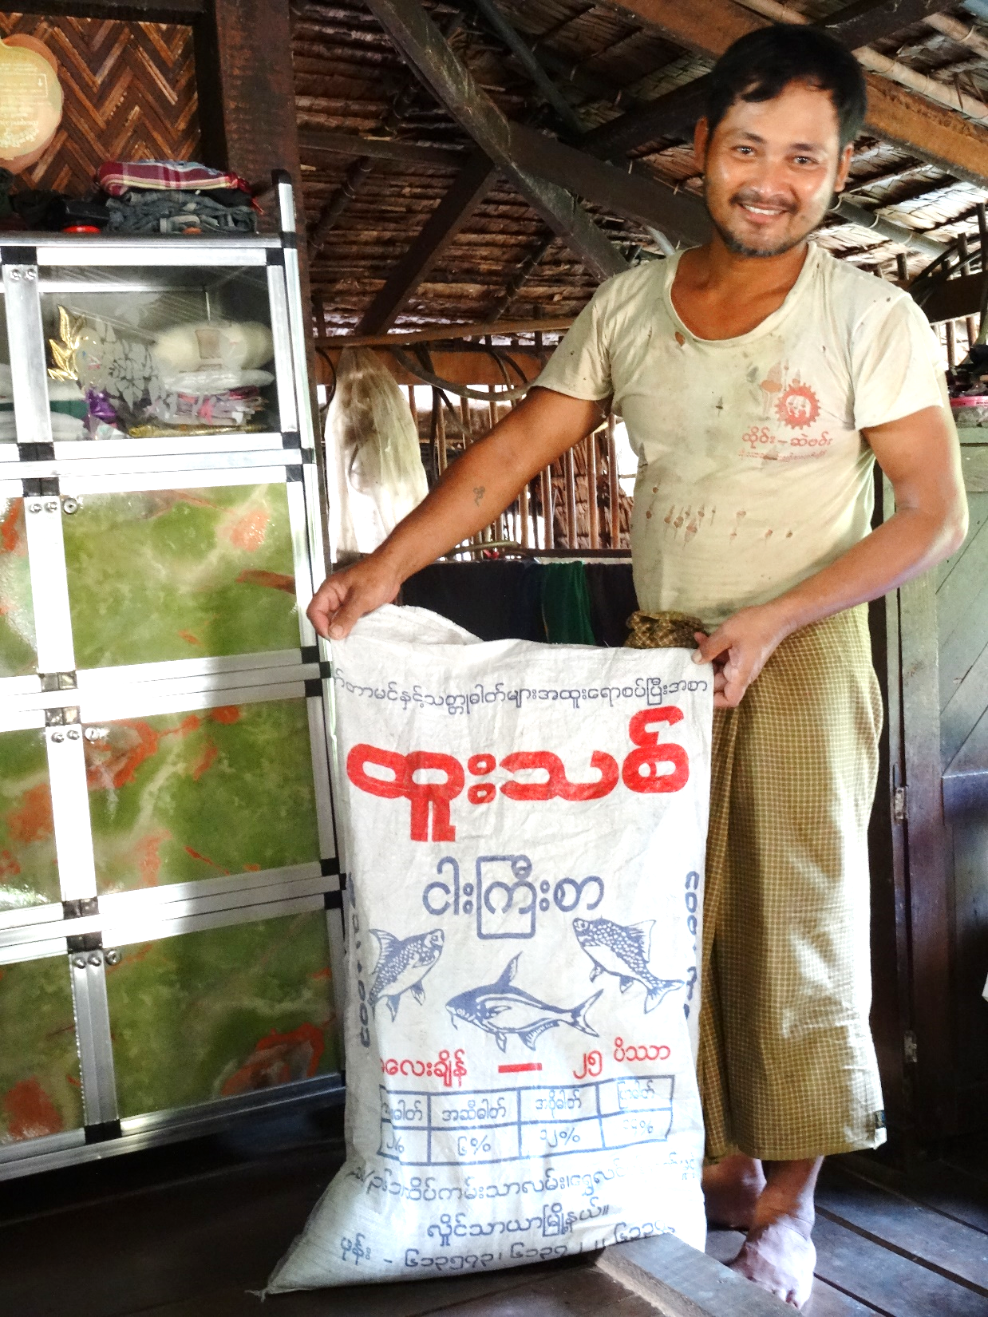
Commercialization, intensification, specialization
Production for sale, not subsistence
Formulated feeds
Larger fingerlings
Deeper ponds
Pumps, aeration
Chemicals
Higher yields
Most aquaculture at ‘intermediate’ stage of development

Slide 7
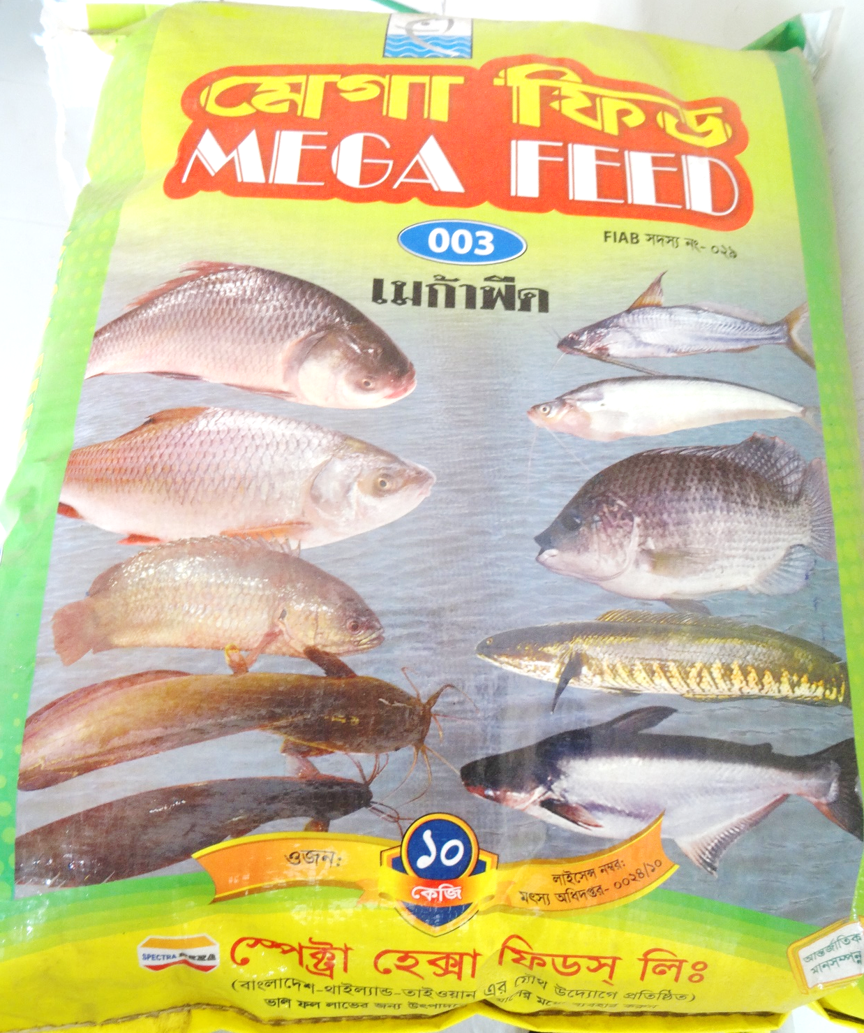
Product cycle
Product introduced
Price
drops
Commoditization
Hernandez et al, 2018

Slide 8
Growth of Off-Farm VC Segments
Enterprise | 2006 | 2016 | % change
Hatchery | 30 | 60 | 100
Nursery | 501 | 1538 | 207
Seed trader | 166 | 265 | 60
Pelleted feed trader | 5 | 11 | 112
Rice bran/oil cake trader | 112 | 175 | 56
Small boats for hire | 115 | 216 | 88
Fish trader | 46 | 68 | 47
Ice factory | 9 | 16 | 82
Mechanical excavator hire | 2 | 24 | 961
Trucks for hire | 1 | 20 | 1900
Nurseries + 200%
Seed traders + 60%
Farm growth facilitated by businesses in ‘upstream’ and ‘downstream’ VC segments
Inventory of enterprises in the aquaculture value chain, in villages with high concentrations of fish farms, Myanmar, 2006-2016 (Belton et al, 2018b)
Notes:
Fish farm growth supported by “quiet revolution”, in off-farm value chain, driven by mainly by SMEs

Slide 9
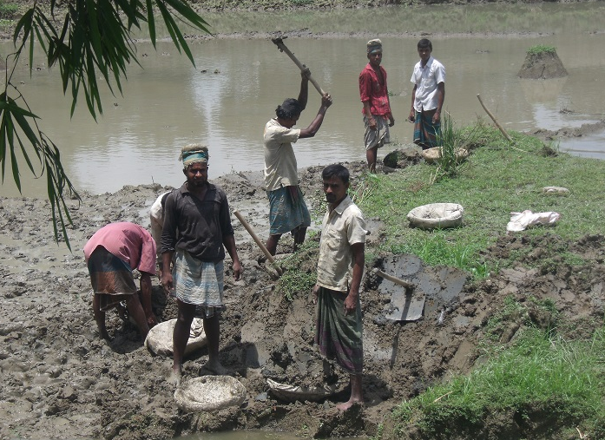
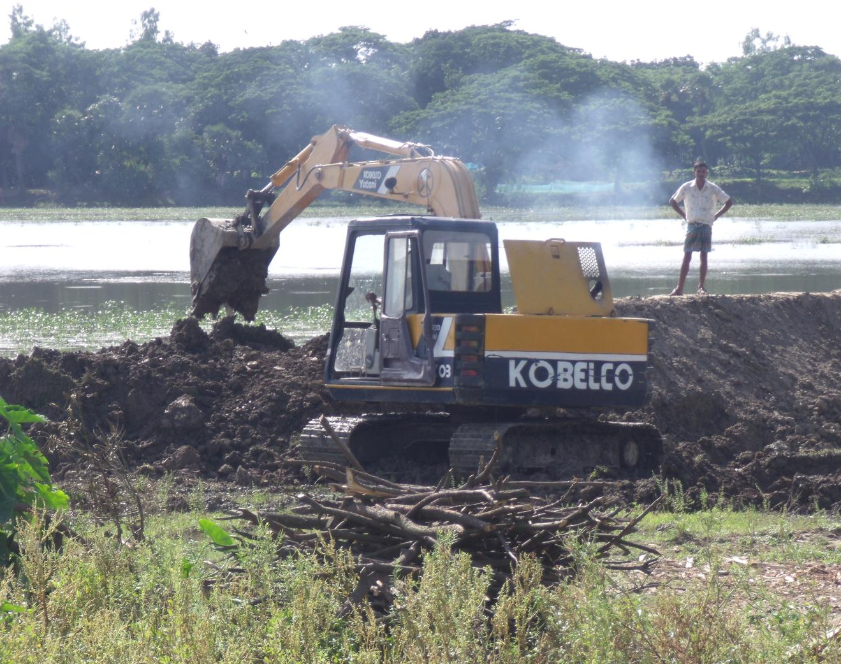
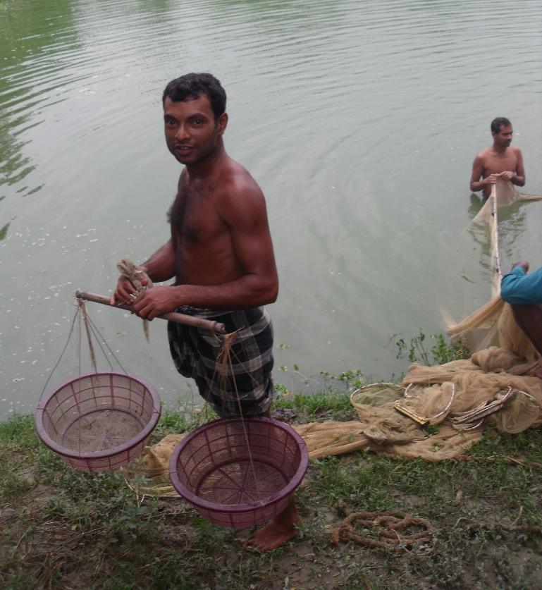
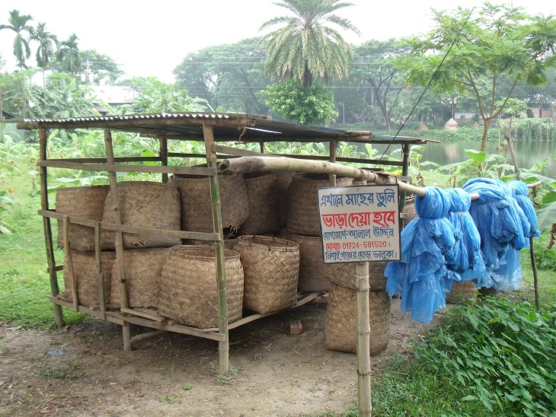
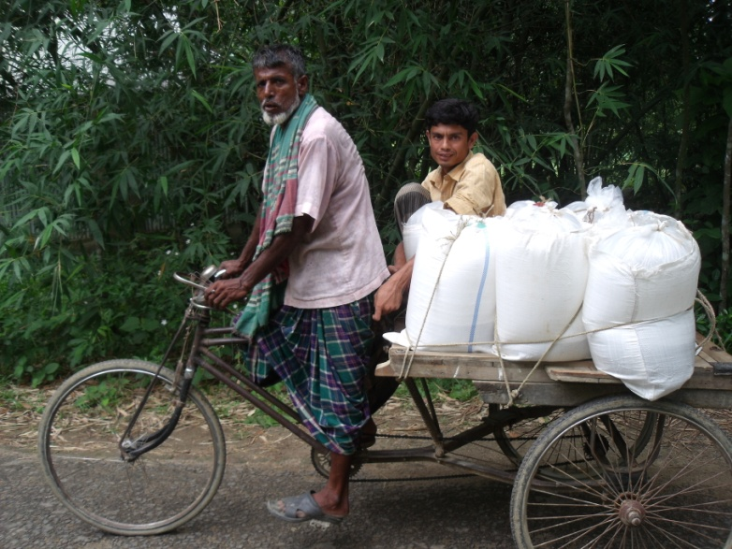
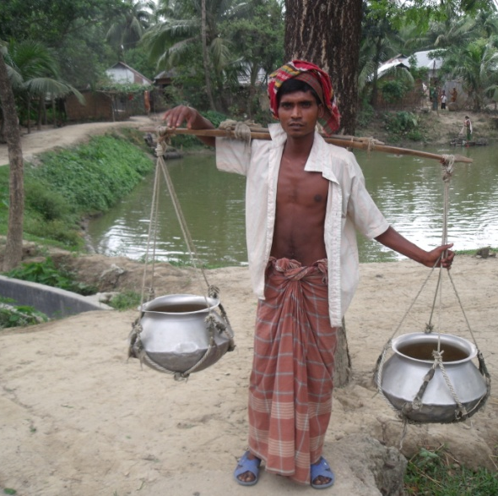

Slide 10
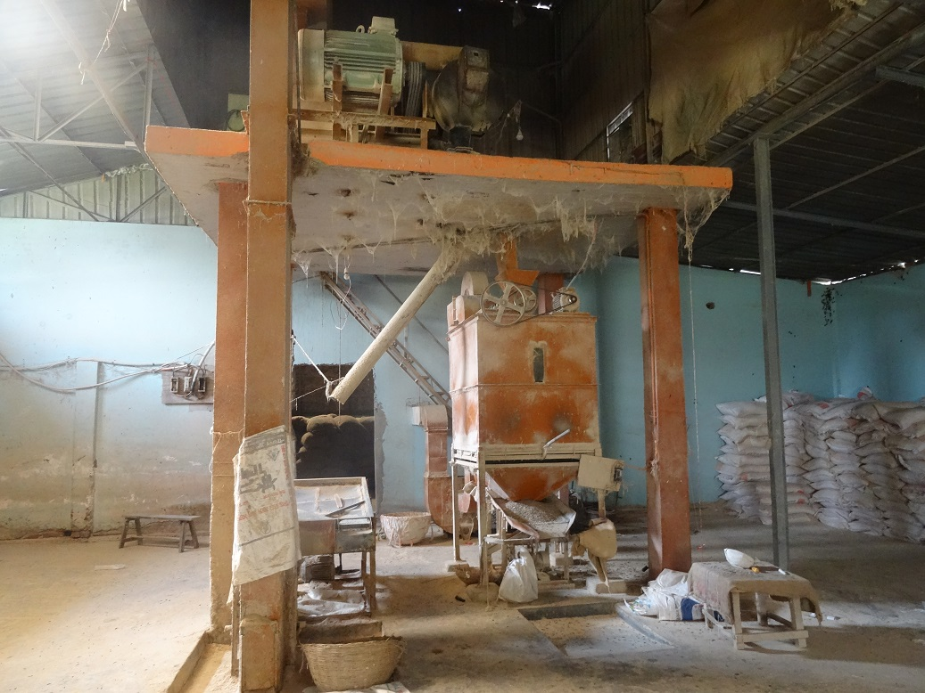
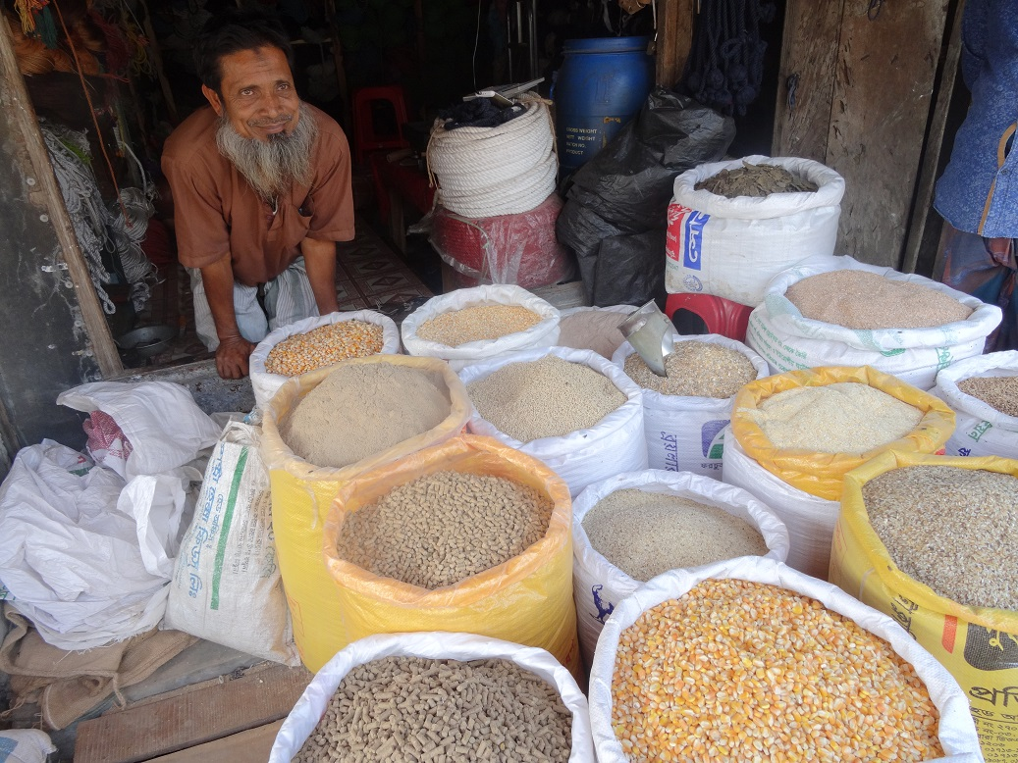
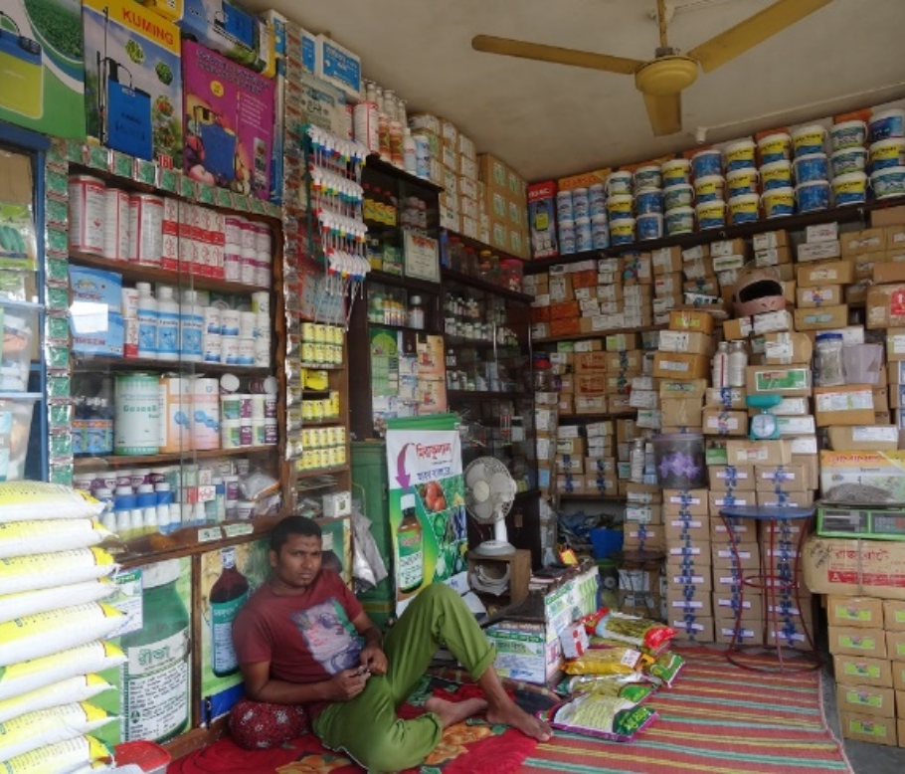
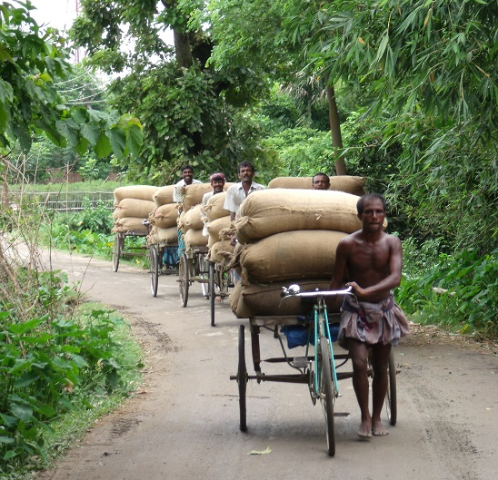
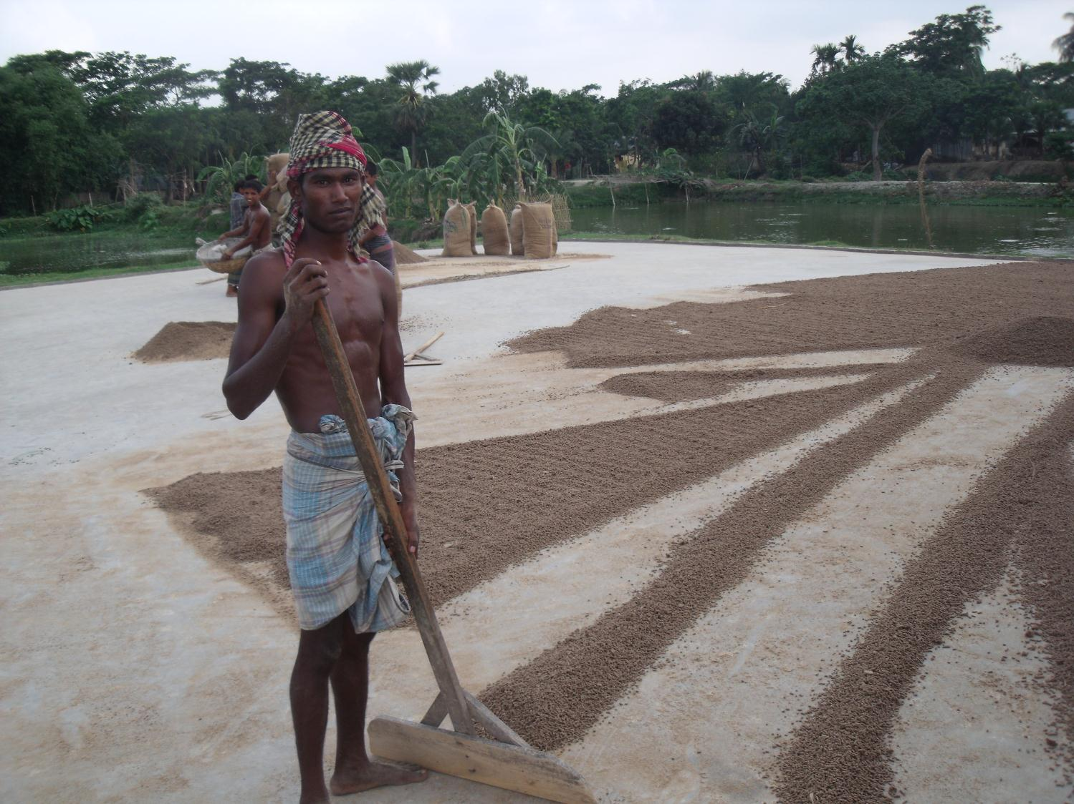
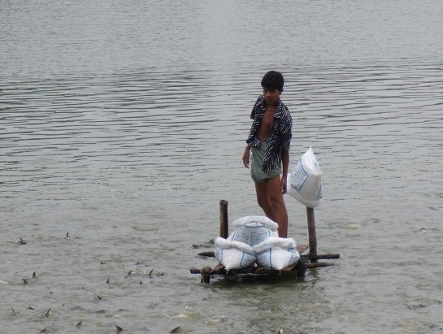

Slide 11
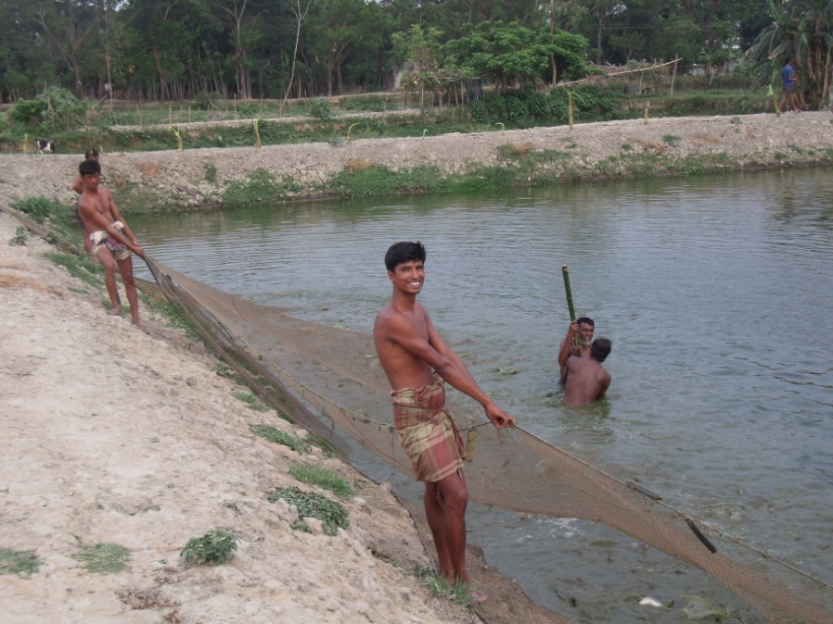
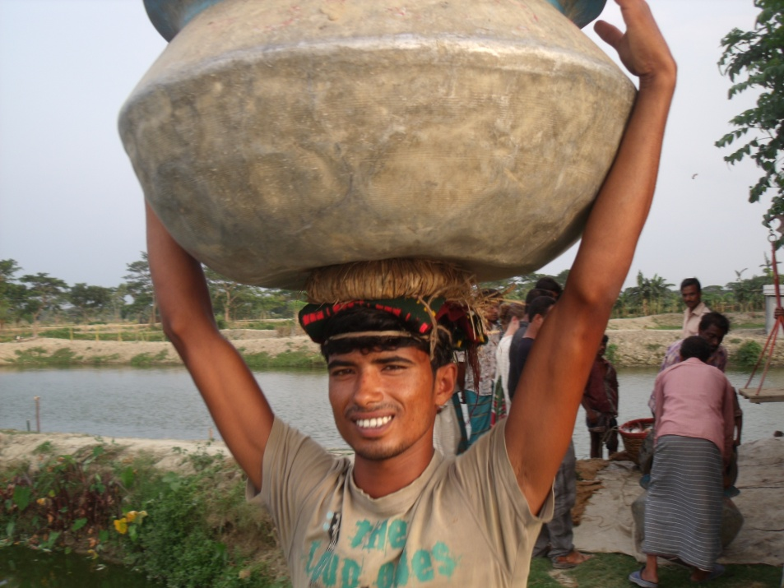
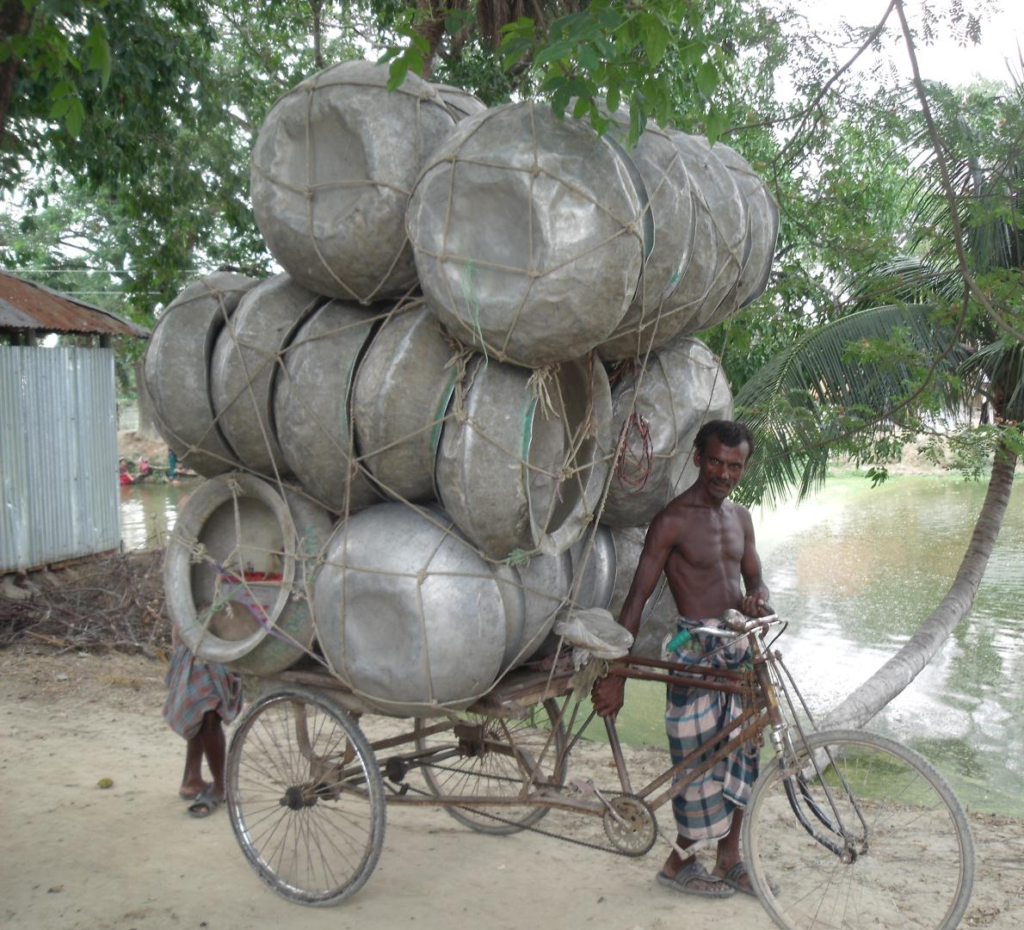
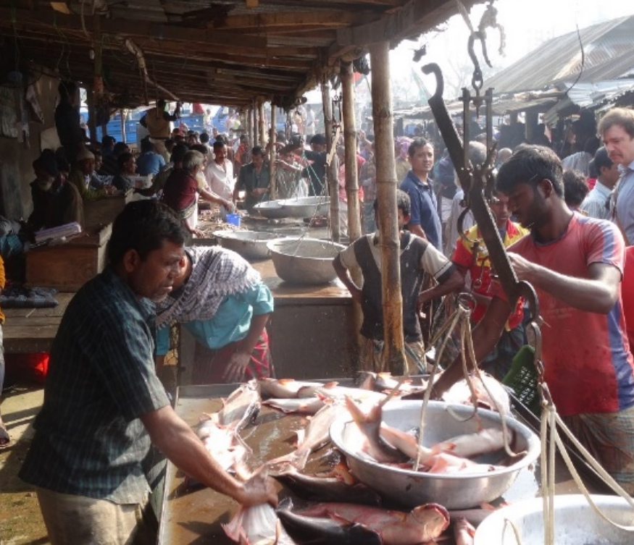
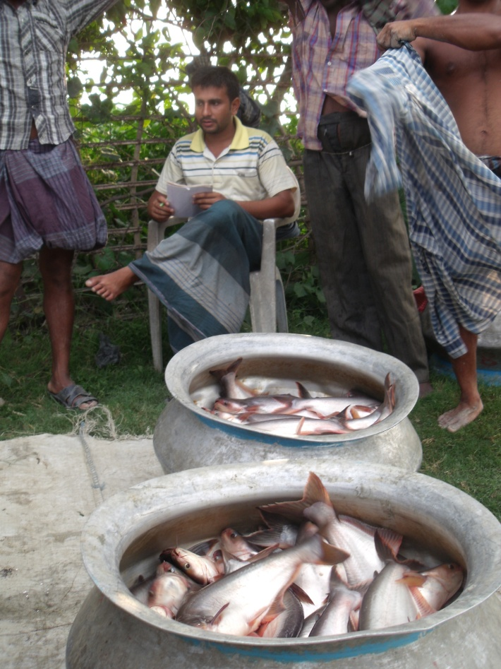
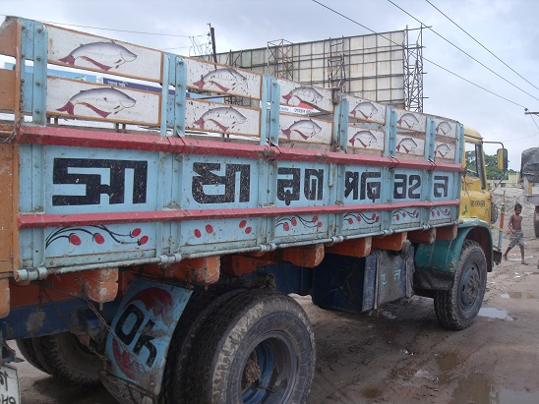

Slide 12
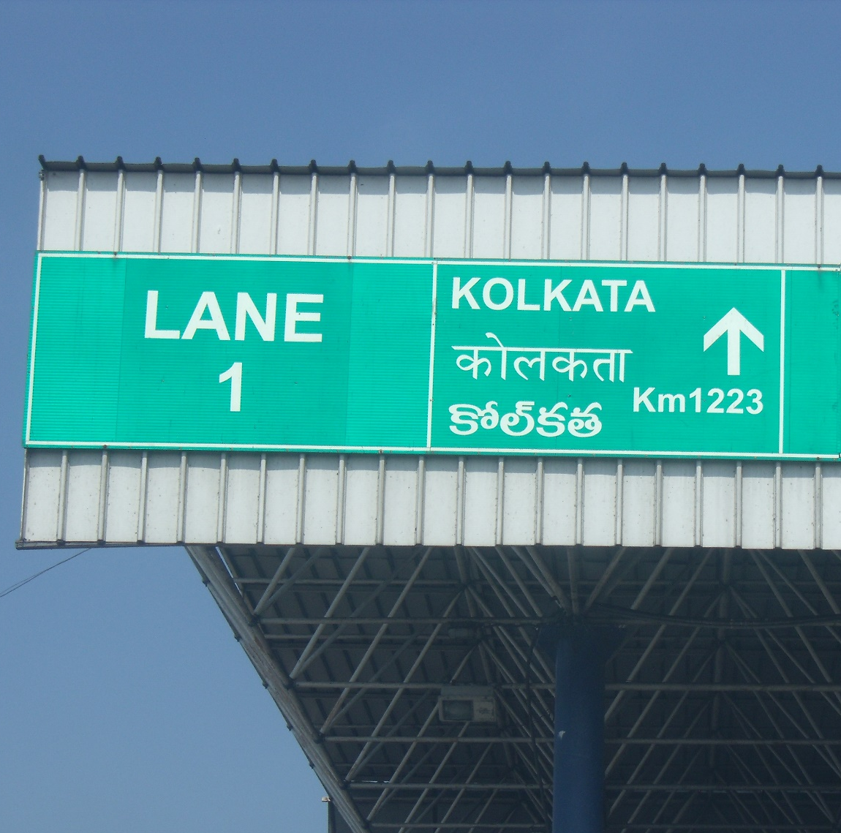
Innovation in off-farm VC segments
Example of Andhra Pradesh (Belton et al, 2018c)
Larger fingerlings, improved seed transport, specialized nursing hubs
Ice, insulated boxes, 3rd party logistics
Clusters facilitate specialization, reduce costs, increase efficiency
Geographical lengthening of value chains

Slide 13
The Quiet Revolution in Aquaculture Value Chains
Driven mainly by changes in domestic demand
Massive growth of farms and enterprises in all VC segments (transforming structure)
Intensification, specialization, constant innovation, greater efficiencies (transforming conduct)
Most farms & firms are SMEs, many livelihood opportunities created, but may change with further modernization
Farmed fish supply growing & diversifying, falling price – greater food security
Notes:
Mutually reinforcing changes across segments

Slide 14
